Slide 1
Introduction to Automation
Copyright 2023 UiPath

Slide 2

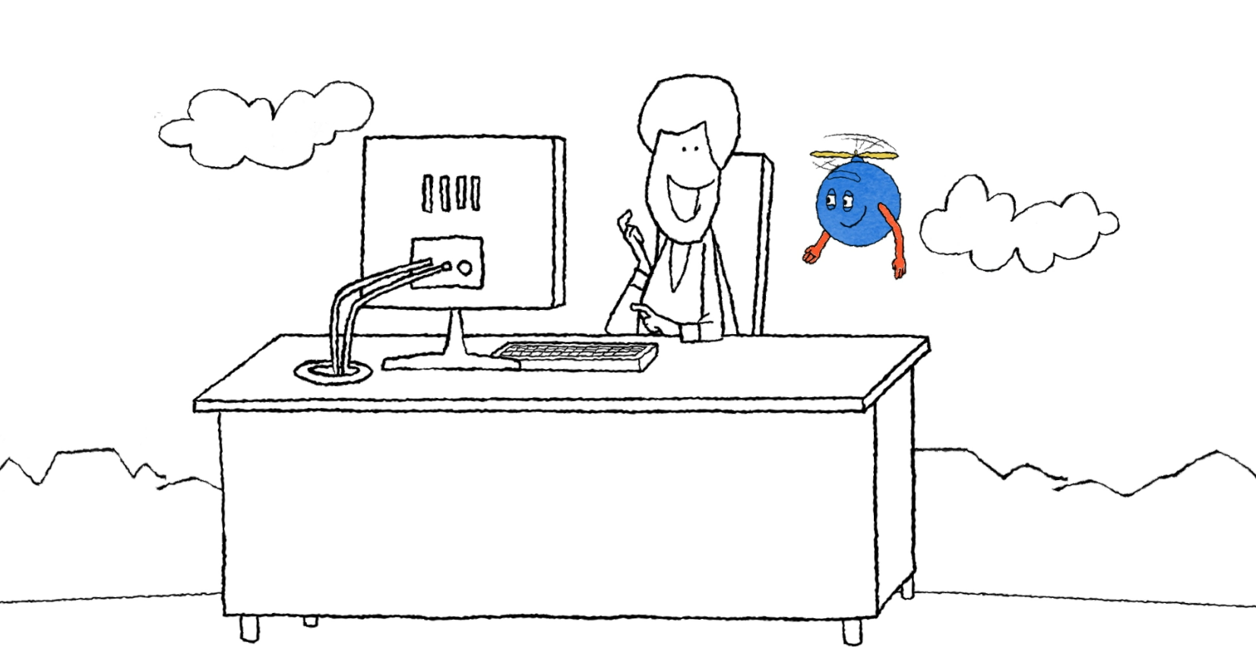
Come one, come all!
This course is for you!
Looking for career opportunities in automation?
New to automation?
Just exploring the UiPath Automation Cloud platform?
Notes:
Facilitator notes:
Explain that this course is a beginner’s course to automation and that it works for everyone, whether they are exploring career opportunities or just want a foot in the world of automation.
Detailed notes:
If you're new to automation and exploring the UiPath Automation Cloud platform or just looking for career opportunities in this field, this course is an excellent fit for you! In this course, you’ll dive into the core aspects of automation using UiPath, learn about the practical benefits for you and your organization, and understand different human-robot collaboration scenarios. You’ll also create your very first automation project as you take your first steps into the world of automation.

Slide 3
“Hello, world!”

Slide 4

Saying hello!
What are your goals for this training?
Who are you?
What is your experience with automation?
What is one fun/interesting fact about you that most people don’t know?
Notes:
Facilitator notes:
Start by greeting and introducing yourself. Include your professional experience working with automation. Then, go through the questions on the slide and provide answers to them.
Now, ask the participants to introduce themselves in a similar way by answering question on the slide. To not spend too much time on the intros, inform the participants that they are to stick only to these questions and to not spend more than 30 seconds on their introductions.

Slide 5
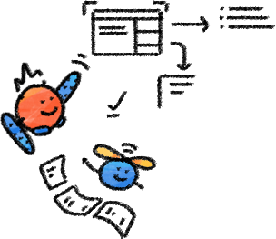

Physical classroom rulebook
The sessions will be held from 9:00 – 12:00 pm.
You will be given time after every topic to ask questions.
If you haven’t already, check your emails and follow instructions to download the files required for this training.
You can provide your feedback to the instructor via email by the end of the session.
Notes:
Facilitator notes:
Go through all the points on the slide.

Slide 6

Virtual classroom rulebook
The sessions will be held from 9:00 – 16:00.
Ensure you have only one participant per device.
Unmute yourself wisely.
Use the chat in the conferencing app to claim a question spot.
Use your webcam, when possible, at least while performing exercises.
Note that the training will be recorded.
If you haven’t already, check your emails and follow instructions to download the files required for this training.
To make the best of this learning experience, go through the prerequisite courses/materials before this training.
You can provide your feedback to the instructor via email by the end of the session.
Notes:
Facilitator notes:
Go through all the points on the slide.

Slide 7

How to make the best of this training
Ask questions. It is an opportunity for clarification and further discussion.
Take breaks. We have scheduled breaks to allow everyone to check in to email/VM.
Be on time. At the start of the day and when returning from breaks.
Be prepared. Read the prerequisite materials ahead of the course.
Be engaged. Please turn ON the video, wherever possible, if on the virtual platform and participate in discussions.
Share. Situational viewpoints, automation needs, and collective experiences.
Notes:
Facilitator notes:
Discuss the following guidelines with the class:
No question is a ‘stupid’ question – this is your opportunity to ask us any questions you have!
We have allotted breaks for checking/responding to emails; please refrain from doing so outside of the allotted time.
Please arrive to course on time, (we open meeting 15 min early – and do return from breaks and lunches on time.
During the interactive/problem solving sessions, please turn ON your video and unmute yourself.
Prepare for the session; we’ve provided some materials for you to read; so, please do so.
This is a no judgment environment – we are here because we want to learn together and share our challenges & experiences.

